Slide 1
Overview of the spring 2021 Leapfrog Hospital Safety Grade
  Presented by:
  Missy Danforth, Vice President of Health Care Ratings, The Leapfrog Group
March 2, 2021

Slide 2
Presentation Overview
About the Leapfrog Hospital Safety Grade
Measure Highlights
Scoring Overview
Details of the Courtesy Safety Grade Review Period
Public Reporting
Important Dates
Questions

Slide 3
ABOUT THE LEAPFROG HOSPITAL SAFETY GRADE

Slide 4
What is the Leapfrog Hospital Safety Grade?
The Safety Grade uses up to 27 national patient safety measures from the Centers for Medicare & Medicaid Services (CMS) and the Leapfrog Hospital Survey, and information from other supplemental data sources, to produce a single letter grade representing a hospital’s overall performance in keeping patients safe from preventable harm and medical errors.
The Leapfrog Hospital Safety Grade launched in June 2012.
The Grade is issued two times per year: Spring and Fall. This spring will be the 19th release.
More information is available at www.HospitalSafetyGrade.org
Notes:
Separate program so it does have its own website

Slide 5
Who is eligible for a Leapfrog Hospital Safety Grade?
General acute care hospitals with enough publicly reported data
  Hospitals missing measure scores for more than 6 process/structural measures OR more than 5 outcome measures do not receive a grade.
The Leapfrog Group is not able to calculate a Hospital Safety Grade for certain types of hospitals due to missing data:
  Critical access hospitals
  PPS-exempt hospitals (i.e., cancer)
  VA Hospitals
  Indian Health Services
  Specialty hospitals
Notes:
Missing data threshold for process measures updated due to the removal of SP4 in Fall 2020.

Slide 6
MEASURE HIGHLIGHTS

Slide 7
Measure Selection Criteria
Measures are publicly-reported from national data sources, which reflect individual hospital results, including:
  Leapfrog Hospital Survey
  Centers for Medicare and Medicaid Services data sets
Measures are endorsed or in use by a national measurement entity
Measures are linked to patient safety (“freedom from harm”)
  Directly quantifying patient safety events
  Assessing processes that lead to better outcomes
  Identified by experts as important to patient safety

Slide 8
Spring 2021 Process and Structural Measures
Measure Name | Primary Data Source | Secondary Data Source
Process and Structural Measures (12)
Computerized Physician Order Entry (CPOE) | 2019 or 2020 Leapfrog Hospital Survey | Imputation Model Applied
Bar Code Medication Administration (BCMA) | 2019 or 2020 Leapfrog Hospital Survey | Imputation Model Applied
ICU Physician Staffing (IPS) | 2019 or 2020 Leapfrog Hospital Survey | Imputation Model Applied
Safe Practice 1: Leadership Structures and Systems | 2019 or 2020 Leapfrog Hospital Survey | N/A
Safe Practice 2: Culture Measurement, Feedback & Intervention | 2019 or 2020 Leapfrog Hospital Survey | N/A
Safe Practice 9: Nursing Workforce | 2019 or 2020 Leapfrog Hospital Survey | N/A
Hand Hygiene (Safe Practice 19 or Leapfrog’s new Hand Hygiene Standard) | 2019 or 2020 Leapfrog Hospital Survey | N/A
H-COMP-1: Nurse Communication | CMS | N/A
H-COMP-2:Doctor Communication | CMS | N/A
H-COMP-3: Staff Responsiveness | CMS | N/A
H-COMP-5: Communication about Medicines | CMS | N/A
H-COMP-6: Discharge Information | CMS | N/A

Slide 9
Spring 2021 Outcome Measures
Measure Name | Primary Data Source | Secondary Data Source
Outcome Measures (15)
Foreign Object Retained | CMS | N/A
Air Embolism | CMS | N/A
Falls and Trauma | CMS | N/A
CLABSI (ICU and select wards) | 2019 or 2020 Leapfrog Hospital Survey | CMS
CAUTI (ICU and select wards) | 2019 or 2020 Leapfrog Hospital Survey | CMS
SSI: Colon | 2019 or 2020 Leapfrog Hospital Survey | CMS
MRSA | 2019 or 2020 Leapfrog Hospital Survey | CMS
C. Diff. | 2019 or 2020 Leapfrog Hospital Survey | CMS
PSI 3: Pressure Ulcer Rate | CMS | N/A
PSI 4: Death Rate among Surgical Inpatients with Serious Treatable Complications | CMS | N/A
PSI 6: Iatrogenic Pneumothorax Rate | CMS | N/A
PSI 11: Postoperative Respiratory Failure Rate | CMS | N/A
PSI 12: Perioperative PE/DVT Rate | CMS | N/A
PSI 14: Postoperative Wound Dehiscence Rate | CMS | N/A
PSI 15: Unrecognized Abdominopelvic Accidental Puncture or Laceration | CMS | N/A

Slide 10
New Imputation Model
In September 2020, Leapfrog was notified by the American Hospital Association (AHA) that it would not be renewing Leapfrog’s data license for their AHA Annual Survey and Health Information Technology Supplement datasets used in the Hospital Safety Grade. These two datasets have been used by Leapfrog since 2012 to assign scores to hospitals that decline to publicly report via the Leapfrog Hospital Survey on Computerized Physician Order Entry (CPOE), Bar Code Medication Administration (BCMA), and ICU Physician Staffing (IPS).
Effective with the spring 2021 Hospital Safety Grade, if a hospital is missing a publicly reported score from the Leapfrog Hospital Survey on Computerized Prescriber Order Entry (CPOE), Bar Code Medication Administration (BCMA), and/or ICU Physician Staffing (IPS), the new 2-step imputation model will be applied for each of the three applicable measures.

Slide 11
Step 1: Use a hospital’s most recent score on the measure (applies to CPOE, BMCA, and IPS)
If the hospital had a score assigned by Leapfrog in the previous four rounds of grades (i.e., fall 2020, spring 2020, fall 2019, spring 2019), the hospital is assigned the most recent score on that measure in the current Hospital Safety Grade (i.e., spring 2021).
Example of Step 1:
A hospital did not submit a Leapfrog Hospital Survey in 2019 or 2020. Therefore, in the fall 2020 Hospital Safety Grade, the hospital’s scores for CPOE, BCMA, and IPS were assigned by Leapfrog based on other supplemental data sources. In the fall 2020 Hospital Safety Grade, the hospital’s CPOE score was 45, BCMA score was 45, and IPS score was 85. For the spring 2021 Hospital Safety Grade, the score of 45 is used for CPOE, 45 is used for BCMA, and 85 is used for IPS.

Slide 12
Step 2: Use the mean of the scores assigned to other “like” hospitals (applies to CPOE and BCMA only)
The hospital is assigned to a cohort of other similar hospitals using three or four hospital characteristics obtained from the most recent CMS Impact File: (1) urban/rural status, (2) safety net status (determined by disproportionate share hospital patient percentage), (3) number of beds, and (4) teaching status (determined by Resident to Bed Ratio). Teaching Status is only used for urban cohorts.
The hospital is assigned the mean score of that cohort. The mean score is calculated based on hospitals that have a score in the current round (i.e., spring 2021) from either Leapfrog’s publicly reported Survey Results or Step 1 of the imputation model.
Example of Step 2:
The hospital is missing scores for CPOE, BCMA, and IPS because they have never submitted a Leapfrog Hospital Survey or had data available via other supplemental data sources. In fact, due to missing data, they have never received a Hospital Safety Grade. Therefore, in the spring 2021 Hospital Safety Grade, the hospital will be assigned scores based on the mean CPOE and BCMA scores of other similar hospitals in the U.S. and may receive a Hospital Safety Grade for the first time.

Slide 13
Hospital Characteristics used in Step 2
Characteristic | Column in CMS Impact File | Criteria
Urban/rural status | URGEO (Column I) | Urban Rural
Safety net status | DSHPCT (Column Y) | Non-safety net: DSHPCT is less than 0.4031* Safety net: DSHPCT is greater than or equal to 0.4031* *0.4031 is the 80th percentile of the IMPACT file.
Number of Beds | Beds (Column U) | Fewer than 100 beds 100 or more beds
Teaching status | Resident to Bed Ratio (Column S) | Non-teaching: Resident to bed Ratio equals 0 Teaching: Resident to bed ratio is greater than 0

Slide 14
“Like” hospital cohorts used in Step 2
Cohort # | Urban/Rural Status | Safety Net Status | Teaching Status | Number of Beds | Step 2 CPOE Score (Mean of Cohort) | Step 2 BCMA Score (Mean of Cohort)
Cohort 1 | Rural | Non-Safety Net | Not Applicable to Rural | Fewer than 100 beds | 65 | 68
Cohort 2 | Rural | Non-Safety Net | Not Applicable to Rural | 100 or more beds | 76 | 78
Cohort 3 | Rural | Safety Net | Not Applicable to Rural | Fewer than 100 beds | 66 | 68
Cohort 4 | Rural | Safety Net | Not Applicable to Rural | 100 or more beds | 68 | 76
Cohort 5 | Urban | Non-Safety Net | Non-Teaching | Fewer than 100 beds | 80 | 78
Cohort 6 | Urban | Non-Safety Net | Non-Teaching | 100 or more beds | 86 | 86
Cohort 7 | Urban | Non-Safety Net | Teaching | Fewer than 100 beds | 81 | 77
Cohort 8 | Urban | Non-Safety Net | Teaching | 100 or more beds | 86 | 85
Cohort 9 | Urban | Safety Net | Non-Teaching | Fewer than 100 beds | 72 | 76
Cohort 10 | Urban | Safety Net | Non-Teaching | 100 or more beds | 81 | 83
Cohort 11 | Urban | Safety Net | Teaching | Fewer than 100 beds | 73 | 64
Cohort 12 | Urban | Safety Net | Teaching | 100 or more beds | 89 | 85

Slide 15
Reporting Periods for Leapfrog Hospital Survey Measures
2019 Leapfrog Hospital Results
  CPOE, BCMA, ICU Physician Staffing, and the 4 NQF Safe Practices will be displayed as “2019”
  CLABSI, CAUTI, MRSA, C. Diff, and SSI Colon will be 07/01/2018 – 06/30/2019
2020 Leapfrog Hospital Survey Results Survey Measures
  CPOE, BCMA, ICU Physician Staffing, 3 NQF Safe Practices, and Hand Hygiene will be displayed as “2020”
  CLABSI, CAUTI, MRSA, C. Diff, and SSI Colon will be 01/01/2019 – 12/31/2019

Slide 16
Reporting Periods for CMS Measures
  The reporting period for the 5 Patient Experience measures will be 01/01/2019 – 12/31/2019
  The reporting period for the 5 infection measures will be 01/01/2019 – 12/31/2019 (only used for hospitals that did not report via the 2019 or 2020 Leapfrog Hospital Survey)
  The reporting period for the three HAC measures and seven PSI measures
  will be 07/01/2017 – 06/30/2019

Slide 17
Summary of Measure Updates Since fall 2020 –
Process/Structural Measure Domain
CPOE and BCMA
  Updated for hospitals that (re)submitted a 2020 Survey after September 30
  No updates for hospitals maintaining 2019 Survey Results
  New imputation model applied for hospitals missing a measure score
  No updates to points assigned to Survey Results
ICU Physician Staffing
  Updated for hospitals that (re)submitted a 2020 Survey after September 30
  No updates for hospitals maintaining 2019 Survey Results
  New imputation model applied for hospitals with recent past score (Step 1 only).
  No updates to points assigned to Survey Results
NQF Safe Practices and Hand Hygiene
  Updated for hospitals that (re)submitted a 2020 Survey after September 30, including the use of the new Hand Hygiene measure
  No updates for hospitals maintain 2019 Survey Results, Safe Practice 19 score will be used for Hand Hygiene
  No updates to point assigned to Survey Results
5 Patient Experience Domains
  Updated for all hospitals receiving a spring 2021 Safety Grade

Slide 18
Summary of Measure Updates Since fall 2020 –
Outcome Measure Domain
3 HAC Measures
  No updates
5 HAI Measures
  Updated for hospitals that submitted Section 7 of the 2020 Survey after September 30 (data source is now Leapfrog Hospital Survey, not CMS)
  Updated for hospitals using CMS data (i.e., did not submit Section 7 of the 2019 or 2020 Leapfrog Hospital Survey)
  No updates for hospitals maintaining 2019 Survey Results
7 PSI Measures
  No updates

Slide 19
SCORING OVERVIEW

Slide 20
Weighting Process
Two measure domains, each weighted 50%:
  Process/structural measures
  Outcome measures
Three criteria for weighting individual measures:
  Strength of evidence (rating of 1 or 2)
  Opportunity (rating of 1-3), based on coefficient of variation
  Impact (rating of 1, 2, 3) based on:
    number of patients possibly affected by the event (0, 1, 2, 3)
    severity of harm to individual patients (1, 2, 3)
Weight Score = [Evidence + (Opportunity x Impact)]
Notes:
As a reminder the scoring methodology hasn’t changed since June 2012
Strength of evidence – typically comes from NQF-endorsing materials
Opportunity – based on coefficient of variation, changes to weights are typically due to the opportunity ratings
Impact – based on number of patients potentially affected by the event and severity of harm to patients

Slide 21
Z-Score Methodology
Standardizes data from individual measures with different scales
Counts how many standard deviations a hospital’s score on the measure is away from the mean
Mean is set to 0
  Negative z-score: worse than the mean
  Positive z-score: better than the mean
How to Calculate Z-Score from Raw Measure Score:
  Process/structural measures:
    (Raw Measure Score – Mean)/Standard Deviation
  Outcome Measures:
    (Mean – Raw Measure Score)/Standard Deviation
Notes:
Once we determine measure weight we use a z-score methodology.
Can see the z-score for each individual measure by completing the calculator.
For outcome measures we flip the calculation, this is so that a negative z-score always represents worse than average for both process/structural measures and outcome measures.
All items needed to calculate your z-scores is provided in the calculator and methodology document.

Slide 22
Overall Numerical Score
Sum the z-score for each measure multiplied by the weight for each measure
If a measure score is missing, the weight for that measure is re-apportioned to other measures within the same domain
3.0 is added to each hospital’s final numerical score to avoid possible confusion with interpreting negative patient safety scores
3.0 + CPOE z-score X CPOE weight + IPS z-score X IPS weight + CLABSI z-score X CLABSI weight
. . . etc.
Notes:
Missing data, didn’t report, sample size was too small, the measure doesn’t apply etc.
You can see how weights are reapportioned by completing the calculator.

Slide 23
Dealing with Missing Data
If a hospital is missing a measure score for any measure, the standard weight of that measure is redistributed to the other measures in the same measure domain. The new weight for each measure within the domain is calculated by re-apportioning the standard weight assigned to the measure with the missing score to other measures within the same domain.
For example, if a hospital is missing a measure score for ICU Physician Staffing because the hospital does not operate an adult or pediatric medical and/or surgical ICU, the standard weight of 7.3% will be re-apportioned to the remaining 11 measures within the process/structural measure domain.
To calculate the new weight of each of the remaining 11 measures in the process/structural measure domain, hospitals can use the formula below or use the Leapfrog Hospital Safety Grade Calculator ©, which can be found on the Safety Grade Review Website. Note that each domain contributes to 50% of the overall letter grade.
[Standard measure weight / (sum of standard weights for the remaining 12 measures in the process/structural measure domain)]*50% = updated measure weight

Slide 24
DETAILS OF THE COURTESY SAFETY GRADE REVIEW PERIOD
Notes:
Safety Grade Review Period opened last Wednesday, September 18 and will remain open until October 8

Slide 25
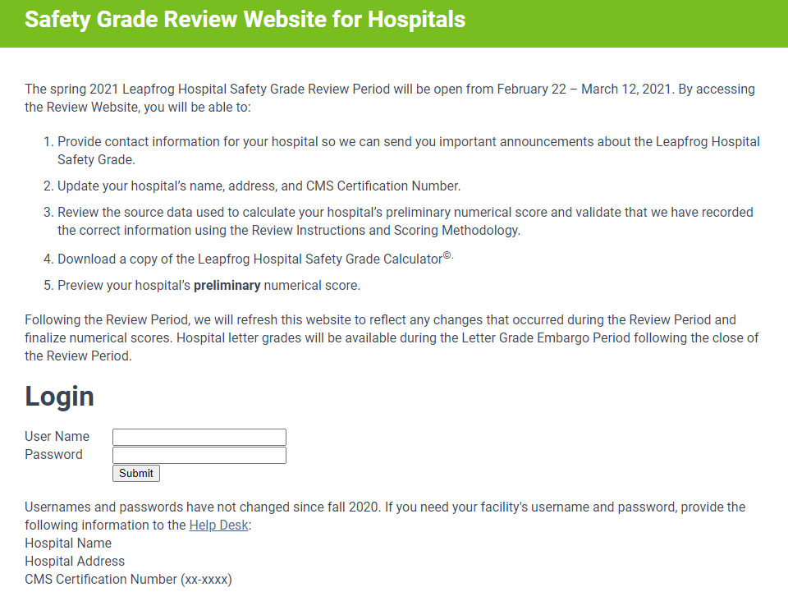
Secure Website for Hospitals to Review their Safety Grade Data
http://www.HospitalSafetyGrade.org/data-review
Usernames and passwords
are emailed to Leapfrog Hospital Survey participants and mailed to hospital CEO’s all others. You can also retrieve your username and password via the Help Desk.
Spring 2021 Review Period
February 22 – March 12

Slide 26
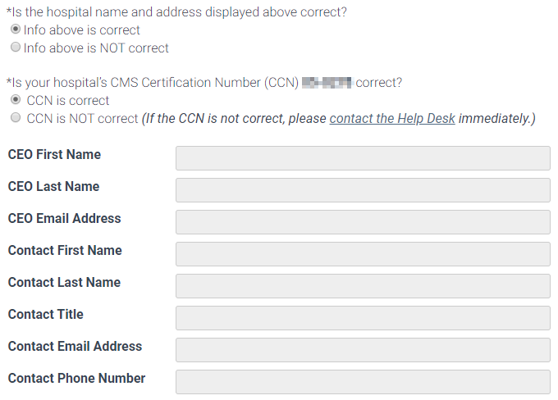
Contact Information
Notes:
On the first page of the Review Website, you’ll verify some demographic information and input your CEO’s contact information as well as contact information for the person completing the review. It’s important this information is correct because we use it to update our database, as well as send important Safety Grade announcements to the contact’s email address. The hospital name displayed here will be what is published on the website, so let the Help Desk know if it is not correct.

Slide 27
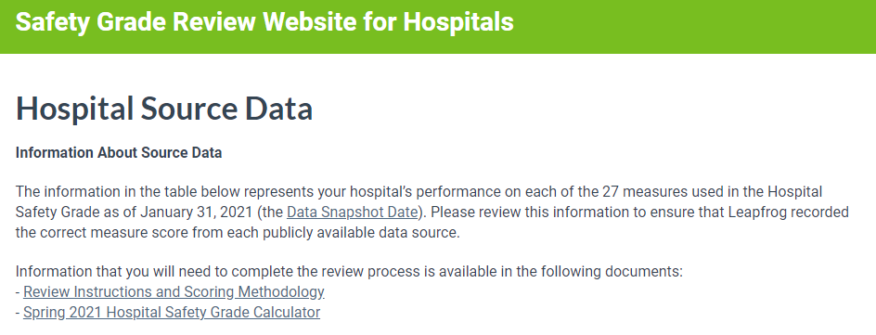
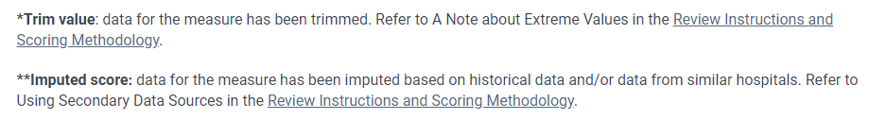
Source Data
Notes:
Updates to instructions – all one document now

Slide 28
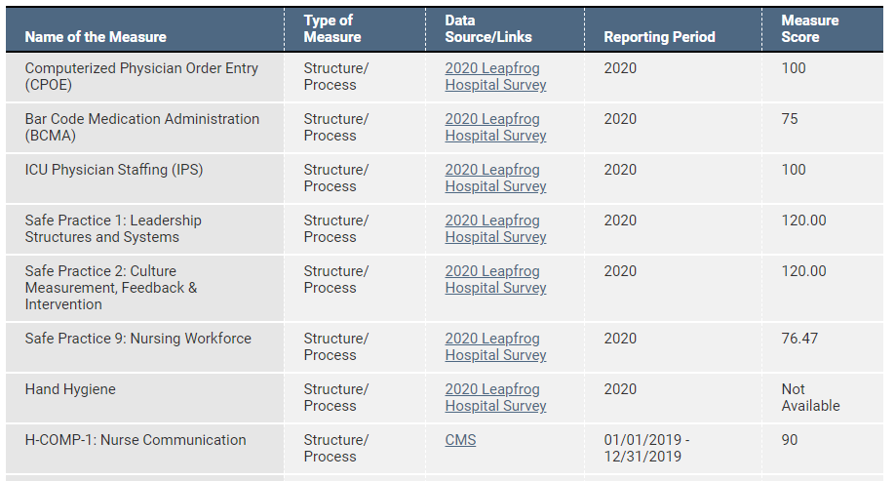
Source Data
Notes:
Csv for most cms files because new search website very confusing
Got rid of radio buttons for ease of review

Slide 29
What if the Measure Score Doesn’t Match the Public Report?
Hospitals must contact the Help Desk immediately if they suspect a measure score is incorrect.
However, they should double check the following information before contacting the Help Desk:
  Data source - the data source listed on the Safety Grade Review Website is what you are referring to when verifying your measure score. You should be using the direct links provided in your Source Data table. For example, if Leapfrog Hospital Survey is listed as the data source for the HAI measures, and you are referring to the CMS HAI data when verifying your measure score, it will not match because that data was not used.
  Measure - the measure listed on the Safety Grade Review Website is what you are referring to when verifying your measure score.
  Reporting period - the reporting period listed on the Safety Grade Review Website is what you are referring to when verifying your measure score.
When you contact the Help Desk about a potential discrepancy, you must include a copy of the public report or a screenshot that shows a different score for the measure. Please be sure the data source, measure name, and reporting period are visible in the screen shot.
If we find a recording error, we will update the measure score and numerical score before assigning a Letter Grade. You will see an updated numerical score during the Letter Grade Embargo Period.
Notes:
If you select No in the table you will need to contact the Help Desk to determine where the discrepancy may be. BUT you should always first check the data source is correct, that you are looking at the correct measure, and that the reporting period you are looking at matches the Review Website. Give an example. Often times its simply that you are looking in the wrong place so the score you’re seeing does not match, but if you check all of these things and still see a discrepancy submit a ticket to the help desk with a screenshot of where you seeing a measure score that does not match and we will help investigate. All of these instructions are provided in the Review Instructions document.

Slide 30
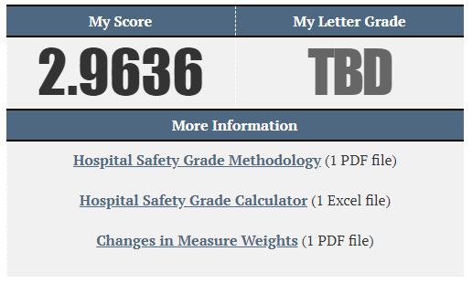
Preview Preliminary Numerical Score
Remember that the numerical scores posted during the Safety Grade Review Period are preliminary as changes do occur during the Safety Grade Review Period.
Final numerical scores will be posted, along with the letter grade, at least two weeks prior to the public announcement.
Hospitals will be alerted via an email sent to the addresses provided in the Contact and Reviewer Information fields.

Slide 31
Letter Grade Embargo Period Scheduled for mid/late April
Hospitals can log back into the Data Review Website to review their final numerical score and letter grade.
Explanation of Letter Grades includes cut-points and distribution of grades.

Slide 32
Hospital Safety Grade Calculator

Slide 33
PUBLIC REPORTING

Slide 34
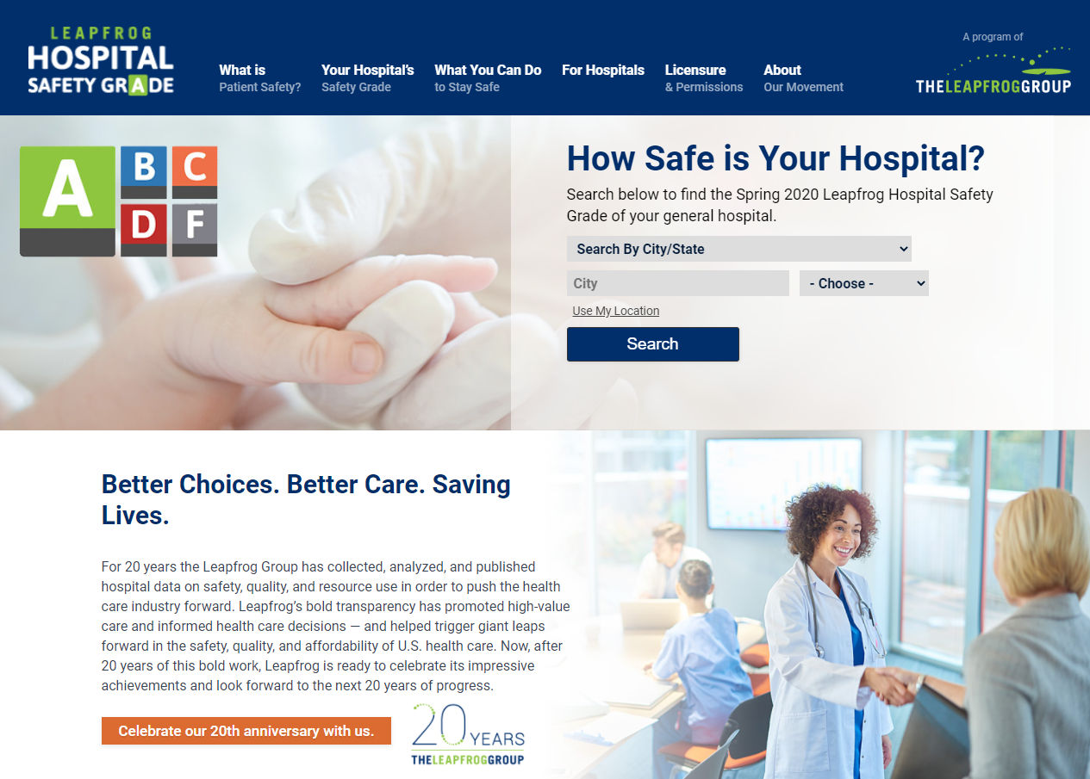
HospitalSafetyGrade.org

Slide 35
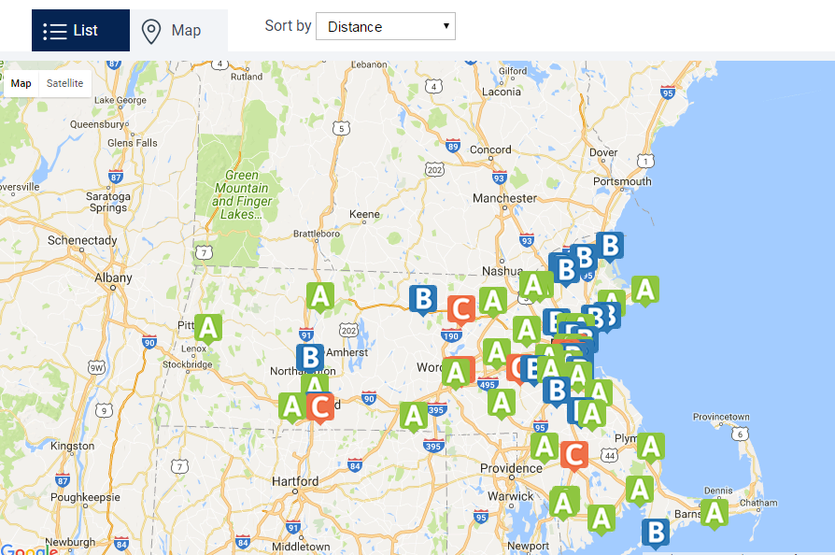
Search by Hospital Name and Location

Slide 36
Hospital Details

Slide 37
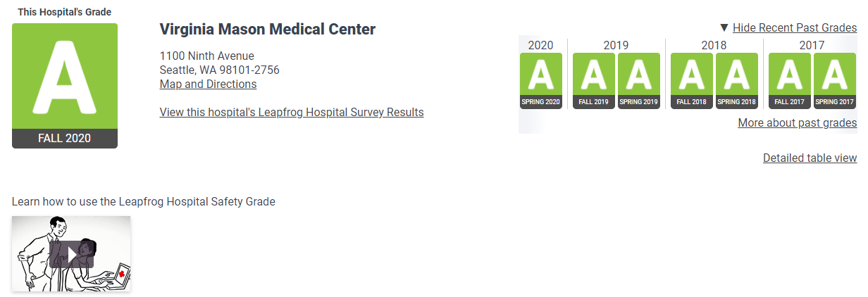
Past Grades

Slide 38
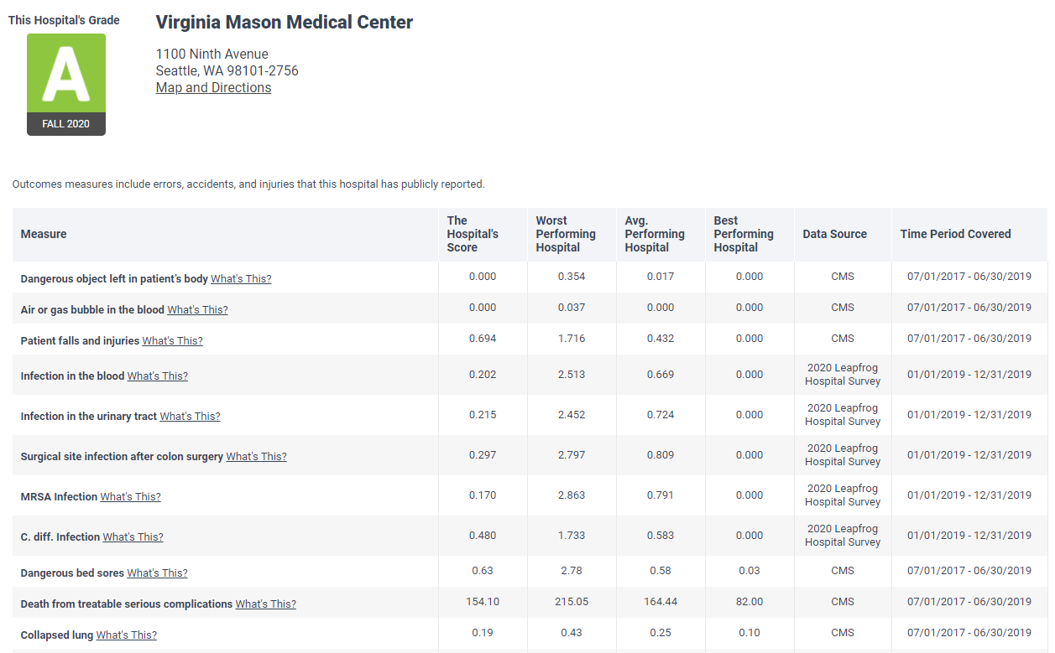
Detailed Table View for Hospitals
Remember to print a copy of your fall 2020 data and letter grade.
Notes:
Easier way to print all of the information from the Fall 2019 grade

Slide 39
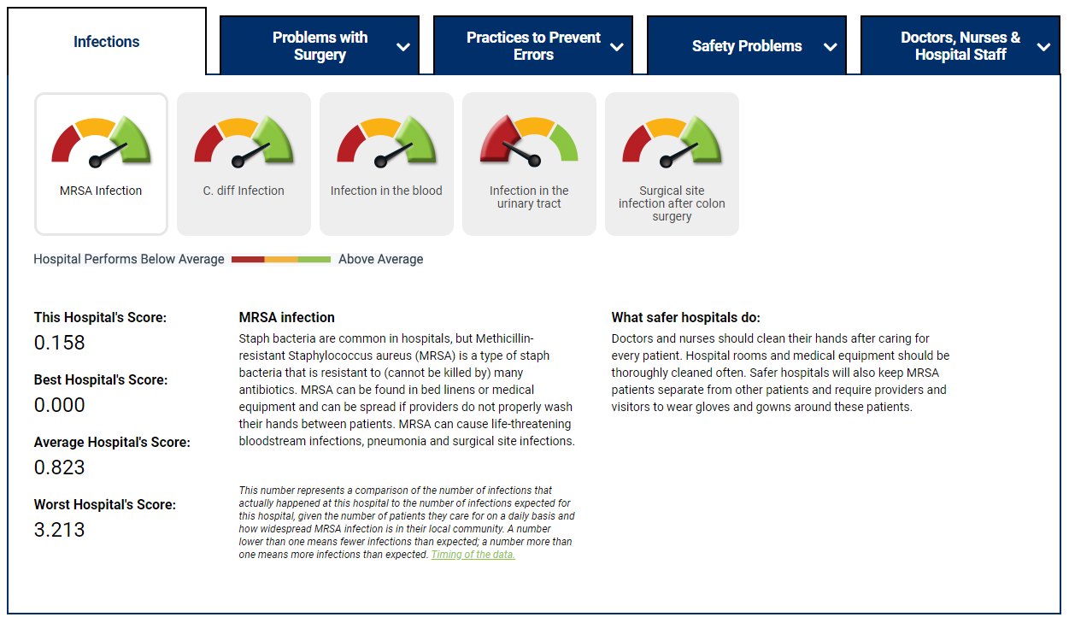
Measure Scores

Slide 40
Important Dates
January 31 - Data Snapshot Date
  For hospitals that have submitted a 2019 Survey or 2020 Survey by December 31 - E-mail sent to the hospital CEO and primary survey contact listed in the profile section of the online Leapfrog Hospital Survey
  For Hospitals that did not submit a 2019 or 2020 Survey – Letter sent to CEO via USPS
  Both e-mails and letters will include:
    Information about the Leapfrog Hospital Safety Grade
    Username/password to a secure website where hospitals can review the source data that Leapfrog used to calculate their numerical score
    Links to the Hospital Safety Grade Help Desk and other helpful documents
February 22 – March 12 – Courtesy 23-week Hospital Safety Grade Review Period
March 2 – Hospital Safety Grade Town Hall Call
Mid/Late-April – Letter Grade Embargo Period
Late April/Early may – Letter grades will be published at www.HospitalSafetyGrade.org
For more information about important dates, visit: http://www.hospitalsafetyscore.org/for-hospitals/updates-and-timelines-for-hospitals

Slide 41
More Information
Leapfrog Help Desk: https://leapfroghelpdesk.zendesk.com
Hospital Safety Grade Website: www.HospitalSafetyGrade.org

