Slide 1
Fall 2021 Leapfrog Hospital Safety Grade Town Hall Call
September 28, 2021

Slide 2
Questions?
Throughout the presentation, if you have a question, please use the Q&A feature in the Zoom toolbar (see below).
Questions will be addressed at the end of the presentation.

Slide 3
Download the slide deck and recording
Attendees can download the slide deck and today’s recording starting tomorrow, September 29, on Leapfrog’s website at https://www.hospitalsafetygrade.org/for-hospitals/key-dates-and-information.

Slide 4
ABOUT THE LEAPFROG HOSPITAL SAFETY GRADE

Slide 5
What is the Leapfrog Hospital Safety Grade?
The Leapfrog Hospital Safety Grade is an A, B, C, D, or F letter grade reflecting how safe hospitals are for patients.
The Leapfrog Hospital Safety Grade launched in June 2012.
The Grade is issued two times per year: Spring and Fall. This fall will be the 20th release.
More information is available at www.HospitalSafetyGrade.org

Slide 6
Who is eligible for a Leapfrog Hospital Safety Grade?
General acute care hospitals with enough publicly reported data
Hospitals missing measure scores for more than 6 process/structural measures OR more than 5 outcome measures or PSI 90 do not receive a grade (updated for Fall 2021). A measure score for PSI 90 is required to receive a fall 2021 Safety Grade.
The Leapfrog Group is not able to calculate a Hospital Safety Grade for certain types of hospitals due to missing data:
Critical access hospitals
PPS-exempt hospitals (i.e., cancer)
VA Hospitals
Indian Health Services
Specialty hospitals

Slide 7
ABOUT THE MEASURES

Slide 8
Measure Selection Criteria
Measures are publicly-reported from national data sources, which reflect individual hospital results, including:
Leapfrog Hospital Survey
Centers for Medicare and Medicaid Services data sets
Measures are endorsed or in use by a national measurement entity
Measures are linked to patient safety (“freedom from harm”)
Directly quantifying patient safety events
Assessing processes that lead to better outcomes
Identified by experts as important to patient safety

Slide 9
Methodology Changes for Fall 2021
Scoring for the Hand Hygiene measure from the Leapfrog Hospital Survey
Reporting period for the NHSN HAI measures from the Leapfrog Hospital Survey and CMS
Replacing 6 individual PSI measures with PSI 90
New standard weight calculation to account for the use of composite measures (i.e., PSI 90)
Missing data threshold for outcome measures
Reporting period for DRA HAC measures

Slide 10
Scoring for the Hand Hygiene measure from the Leapfrog Hospital Survey
100 points will be assigned to hospitals that score in the top two performance categories (i.e., Achieved the Standard and Considerable Achievement) based on their Results from the 2021 Leapfrog Hospital Survey.
N/A will be assigned to hospitals that score in the bottom two performance categories (i.e., Some Achievement and Limited Achievement) meaning that the Hand Hygiene measure will not be used to calculate the fall 2021 Hospital Safety Grade.
However, the mean and standard deviation for the measures will be calculated using all four performance categories, where:
Achieved the standard = 100
Considerable achievement = 100
Some achievement = 40
Limited achievement = 15

Slide 11
Reporting period for the NHSN HAI measures from the Leapfrog Hospital Survey and CMS
To align with CMS, Leapfrog updated the reporting period for the July and August NHSN data pulls for the five HAI measures on the 2021 Leapfrog Hospital Survey to match the reporting period for the five HAI measures that CMS published in July 2021.
Therefore, the reporting period for the HAI measures from the 2021 Leapfrog Hospital Survey and CMS will be 04/01/2019 - 12/31/2019 AND 07/01/2020 - 09/30/2020 (2019Q2-2019Q4 AND 2020Q3).
In addition, Leapfrog will provide a footnote on the Survey Results website and the Leapfrog Hospital Safety Grade website for each of the five HAI measure scores to indicate that the standardized infection ratio (SIR) includes some data collected during the COVID-19 pandemic.

Slide 12
Replacing 6 individual PSI measures with PSI 90
To align with CMS’ efforts to reduce harm to patients from medical and surgical complications, Leapfrog will replace six of the seven individual PSIs in the Leapfrog Hospital Safety Grade with the CMS Medicare PSI 90: Patient Safety and Adverse Events Composite measure, which is made up of 10 component PSIs.
Therefore, starting this fall, the Hospital Safety Grade will include two PSIs:
PSI 4: Death Rate among Surgical Inpatients with Serious Treatable Conditions
CMS PSI 90: Patient Safety and Adverse Events Composite
For the purposes of public reporting on the Hospital Safety Grade website, Leapfrog will display performance on each of the 10 component PSIs included in PSI 90, along with performance on PSI 90.

Slide 13
New standard weight calculation to account for the use of composite measures (i.e., PSI 90)
Starting with the fall 2021 Safety Grade, the number of component measures (i.e., 10 component measures for PSI 90) will be included in the weight score calculation.
Measure Weight Score =
((Evidence + (Impact x Opportunity x Number of Component Measures))
For PSI 90, the number of component measures is 10.
For all other measures, the number of component measures is 1.

Slide 14
Missing data threshold for outcome measures
Leapfrog originally planned to update the missing data threshold for outcome measures from “missing scores for more than 5 outcome measures or PSI 90” to “missing scores for more than 4 outcome measures or PSI 90.”
Hospitals must have a PSI 90 score to receive a Hospital Safety Grade.
However, following a preliminary analysis of hospitals excluded due to missing data, we determined that this change would exclude hospitals that have historically received a grade based on a similar number of measures.
Therefore, we have not updated the missing data threshold for outcome measures. Hospitals missing scores for more than 5 outcome measures or PSI 90 will not receive a fall 2021 Hospital Safety Grade.

Slide 15
Reporting Period for DRA HAC Measures
Leapfrog anticipated that CMS would publish updated DRA HAC rates on data.cms.gov for the reporting period of 07/01/2018-12/31/2019 by August 31, 2021.
Unfortunately, CMS did not update the DRA HAC rate on data.cms.gov by August 31. Therefore, the reporting period for the DRA HAC measures is unchanged from spring 2021: 07/01/2017-06/30/2019.
CMS did publish the updated data on September 20, 2021, which will be used in the spring 2022 Hospital Safety Grade.

Slide 16
Fall 2021 Process and Structural Measures
Measure Name | Primary Data Source | Secondary Data Source
Process and Structural Measures (12)
Computerized Physician Order Entry (CPOE) | 2021 Leapfrog Hospital Survey | Imputation Model Applied
Bar Code Medication Administration (BCMA) | 2021 Leapfrog Hospital Survey | Imputation Model Applied
ICU Physician Staffing (IPS) | 2021 Leapfrog Hospital Survey | Imputation Model Applied
Safe Practice 1: Leadership Structures and Systems | 2021 Leapfrog Hospital Survey | N/A
Safe Practice 2: Culture Measurement, Feedback & Intervention | 2021 Leapfrog Hospital Survey | N/A
Safe Practice 9: Nursing Workforce | 2021 Leapfrog Hospital Survey | N/A
Hand Hygiene | 2021 Leapfrog Hospital Survey | N/A
H-COMP-1: Nurse Communication | CMS | N/A
H-COMP-2:Doctor Communication | CMS | N/A
H-COMP-3: Staff Responsiveness | CMS | N/A
H-COMP-5: Communication about Medicines | CMS | N/A
H-COMP-6: Discharge Information | CMS | N/A

Slide 17
Spring 2021 Outcome Measures
Measure Name | Primary Data Source | Secondary Data Source
Outcome Measures (10)
Foreign Object Retained | CMS | N/A
Air Embolism | CMS | N/A
Falls and Trauma | CMS | N/A
CLABSI (ICU and select wards) | 2021 Leapfrog Hospital Survey | CMS
CAUTI (ICU and select wards) | 2021 Leapfrog Hospital Survey | CMS
SSI: Colon | 2021 Leapfrog Hospital Survey | CMS
MRSA | 2021 Leapfrog Hospital Survey | CMS
C. Diff. | 2021 Leapfrog Hospital Survey | CMS
PSI 4: Death Rate among Surgical Inpatients with Serious Treatable Complications | CMS | N/A
PSI 90: Patient Safety and Adverse Events Composite | CMS | N/A

Slide 18
Reporting Periods for Leapfrog Hospital Survey Measures
2021 Leapfrog Hospital Results
CPOE, BCMA, ICU Physician Staffing, the 3 NQF Safe Practices, and Hand Hygiene will be displayed as “2021”
CLABSI, CAUTI, MRSA, C. Diff, and SSI Colon will be 04/01/2019 – 12/31/2019 AND 07/01/2020 – 09/30/2020

Slide 19
Reporting Periods for CMS Measures
The reporting period for the 5 Patient Experience measures will be 01/01/2019 – 12/31/2019
The reporting period for the 5 infection measures will be 04/01/2019 – 12/31/2019 AND 07/01/2020 – 09/30/2020 (only used for hospitals that did not report via the 2021 Leapfrog Hospital Survey)
The reporting period for the three HAC measures will be 07/01/2017 – 12/31/2019
The reporting period for PSI 4 and PSI 90 will be 07/01/2018 – 12/31/2019

Slide 20
Summary of Measure Updates Since spring 2021 – Process/Structural Measure Domain
CPOE and BCMA
Updated for hospitals that submitted a 2021 Leapfrog Hospital Survey by August 31
Imputation model applied for hospitals missing a measure score
No updates to points assigned to Survey Results
ICU Physician Staffing
Updated for hospitals that submitted a 2021 Leapfrog Hospital Survey by August 31
Imputation model applied for hospitals with a recent past score (Step 1 only).
No updates to points assigned to Survey Results
NQF Safe Practices and Hand Hygiene
Updated for hospitals that submitted a 2021 Leapfrog Hospital Survey by August 31
N/A for hospitals missing a measure score
Update to points assigned to Survey Results
5 Patient Experience Domains
Not updated for any hospital as CMS did not update these data by the August 31 Data Snapshot Date

Slide 21
Summary of Measure Updates Since Spring 2021 – Outcome Measure Domain
3 HAC Measures
Not updated for any hospital as CMS did not update these data by the August 31 Data Snapshot Date.
5 HAI Measures
Updated for all hospitals (both Leapfrog Hospital Survey Results and CMS data have been updated since spring 2021)
PSI Measures
Updated for all hospitals (PSI 4 and PSI 90)

Slide 22
SCORING OVERVIEW

Slide 23
Weighting Process
Two measure domains, each weighted 50%:
Process/structural measures
Outcome measures
Three criteria for weighting individual measures:
Strength of evidence (rating of 1 or 2)
Opportunity (rating of 1-3), based on coefficient of variation
Impact (rating of 1, 2, 3) based on:
number of patients possibly affected by the event (0, 1, 2, 3)
severity of harm to individual patients (1, 2, 3)
Number of measures
Measure Weight Score = [Evidence + (Opportunity x Impact x Number of Measures*)]
*Number of measures equals 1 for all but PSI 90 where number of measures equals 10

Slide 24
Z-Score Methodology
Standardizes data from individual measures with different scales
Counts how many standard deviations a hospital’s score on the measure is away from the mean
Mean is set to 0
Negative z-score: worse than the mean
Positive z-score: better than the mean
How to Calculate Z-Score from Raw Measure Score:
Process/structural measures:
(Raw Measure Score – Mean)/Standard Deviation
Outcome Measures:
(Mean – Raw Measure Score)/Standard Deviation

Slide 25
Overall Numerical Score
Sum the z-score for each measure multiplied by the weight for each measure
If a measure score is missing, the weight for that measure is re-apportioned to other measures within the same domain
3.0 is added to each hospital’s final numerical score to avoid possible confusion with interpreting negative patient safety scores
3.0 + CPOE z-score X CPOE weight + IPS z-score X IPS weight + CLABSI z-score X CLABSI weight . . . etc.

Slide 26
Dealing with Missing Data
If a hospital is missing a measure score for any measure (except for PSI 90; hospitals missing PSI 90 are not graded), the standard weight of that measure is redistributed to the other measures in the same measure domain. The new weight for each measure within the domain is calculated by re-apportioning the standard weight assigned to the measure with the missing score to other measures within the same domain.
For example, if a hospital is missing a measure score for ICU Physician Staffing because the hospital does not operate an adult or pediatric medical and/or surgical ICU, the standard weight will be re-apportioned to the remaining 11 measures within the process/structural measure domain.
To calculate the new weight of each of the remaining 11 measures in the process/structural measure domain, hospitals can use the formula below or use the Leapfrog Hospital Safety Grade Calculator ©, which can be found on the Safety Grade Review Website. Note that each domain contributes to 50% of the overall letter grade.
[Standard measure weight / (sum of standard weights for the remaining 11 measures in the process/structural measure domain)]*50% = updated measure weight

Slide 27
DETAILS OF THE COURTESY SAFETY GRADE REVIEW PERIOD

Slide 28
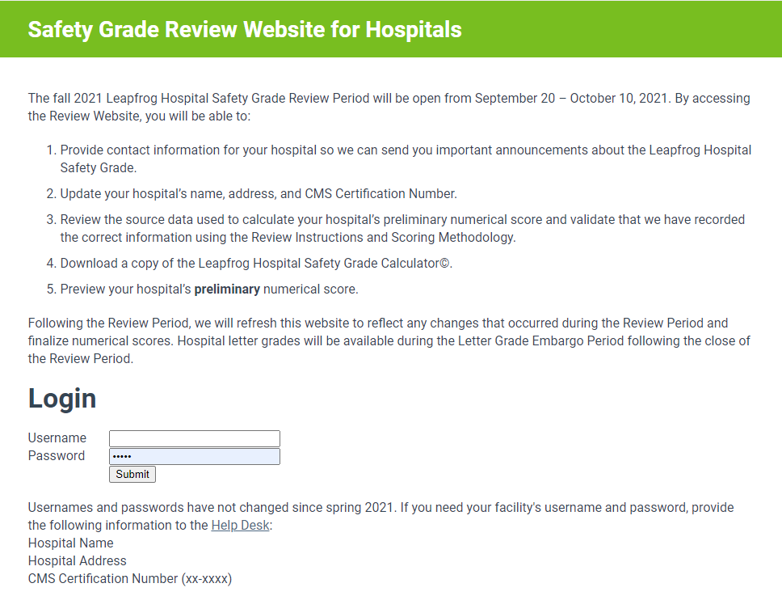
Secure Website for Hospitals to Review their Safety Grade Data
http://www.HospitalSafetyGrade.org/data-review
Usernames and passwords are emailed to Leapfrog Hospital Survey participants and mailed to hospital CEO’s all others. You can also retrieve your username and password via the Help Desk.
Fall 2021 Review Period
September 20 – October 10

Slide 29
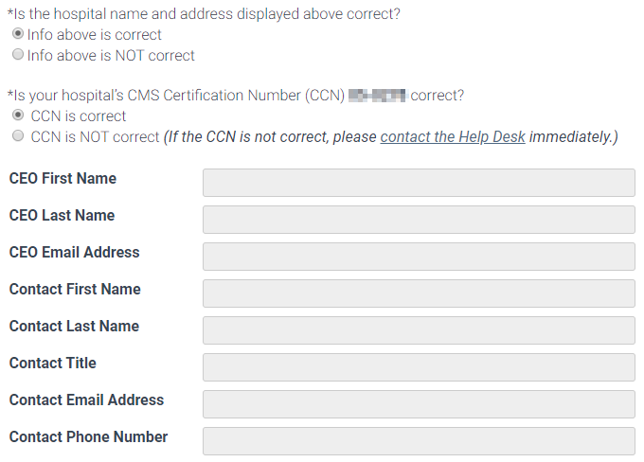
Contact Information

Slide 30
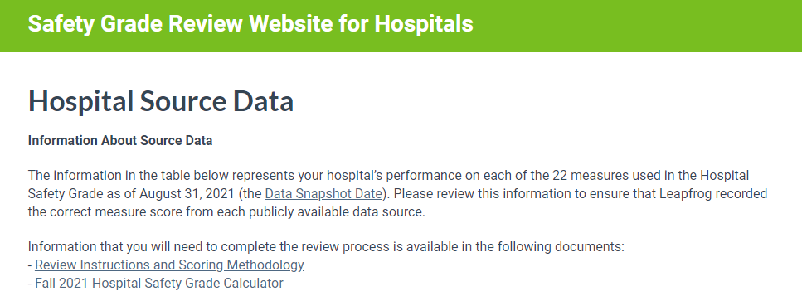
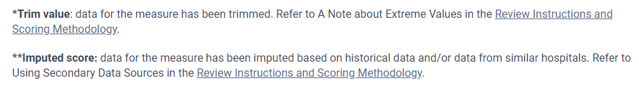
Source Data

Slide 31
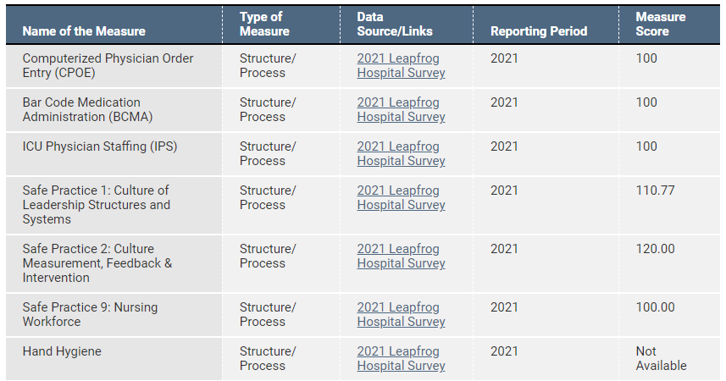
Source Data

Slide 32
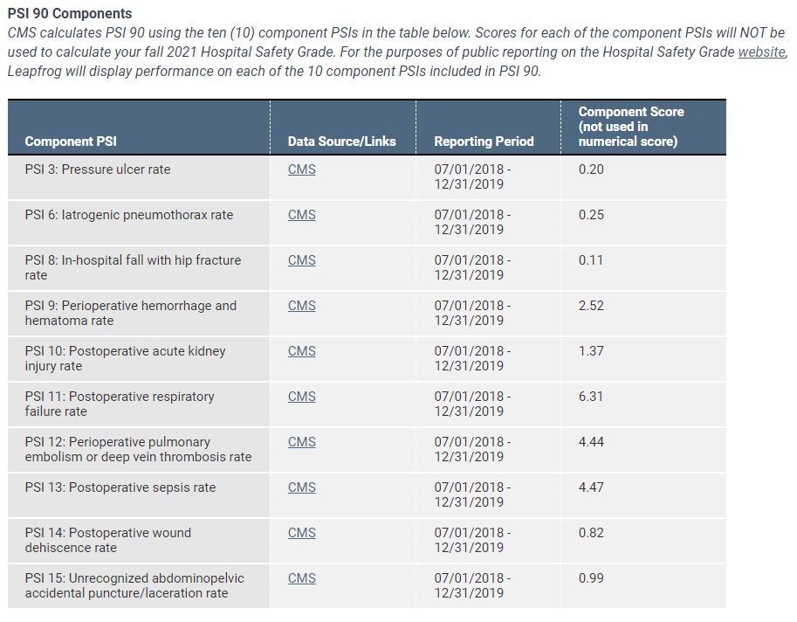
PSI 90 Components – NOT used in scoring

Slide 33
What if the Measure Score Doesn’t Match the Public Report?
Hospitals must contact the Help Desk immediately if they suspect a measure score is incorrect.
However, they should double check the following information before contacting the Help Desk:
Data source - the data source listed on the Safety Grade Review Website is what you are referring to when verifying your measure score. You should be using the direct links provided in your Source Data table. For example, if Leapfrog Hospital Survey is listed as the data source for the HAI measures, and you are referring to the CMS HAI data when verifying your measure score, it will not match because that data was not used.
Measure - the measure listed on the Safety Grade Review Website is what you are referring to when verifying your measure score.
Reporting period - the reporting period listed on the Safety Grade Review Website is what you are referring to when verifying your measure score.
When you contact the Help Desk about a potential discrepancy, you must include a copy of the public report or a screenshot that shows a different score for the measure. Please be sure the data source, measure name, and reporting period are visible in the screen shot.
If we find a recording error, we will update the measure score and numerical score before assigning a Letter Grade. You will see an updated numerical score during the Letter Grade Embargo Period.
Notes:
If you select No in the table you will need to contact the Help Desk to determine where the discrepancy may be. BUT you should always first check the data source is correct, that you are looking at the correct measure, and that the reporting period you are looking at matches the Review Website. Give an example. Often times its simply that you are looking in the wrong place so the score you’re seeing does not match, but if you check all of these things and still see a discrepancy submit a ticket to the help desk with a screenshot of where you seeing a measure score that does not match and we will help investigate. All of these instructions are provided in the Review Instructions document.

Slide 34
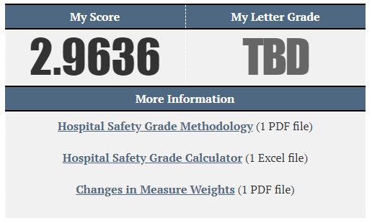
Preview Preliminary Numerical Score
Remember that the numerical scores posted during the Safety Grade Review Period are preliminary as changes do occur during the Safety Grade Review Period.
Final numerical scores will be posted, along with the letter grade, at least two weeks prior to the public announcement.
Hospitals will be alerted via an email sent to the addresses provided in the Contact and Reviewer Information fields.

Slide 35
Letter Grade Embargo Period Scheduled for late October
Hospitals can log back into the Data Review Website to review their final numerical score and letter grade.
Explanation of Letter Grades includes cut-points and distribution of grades.

Slide 36
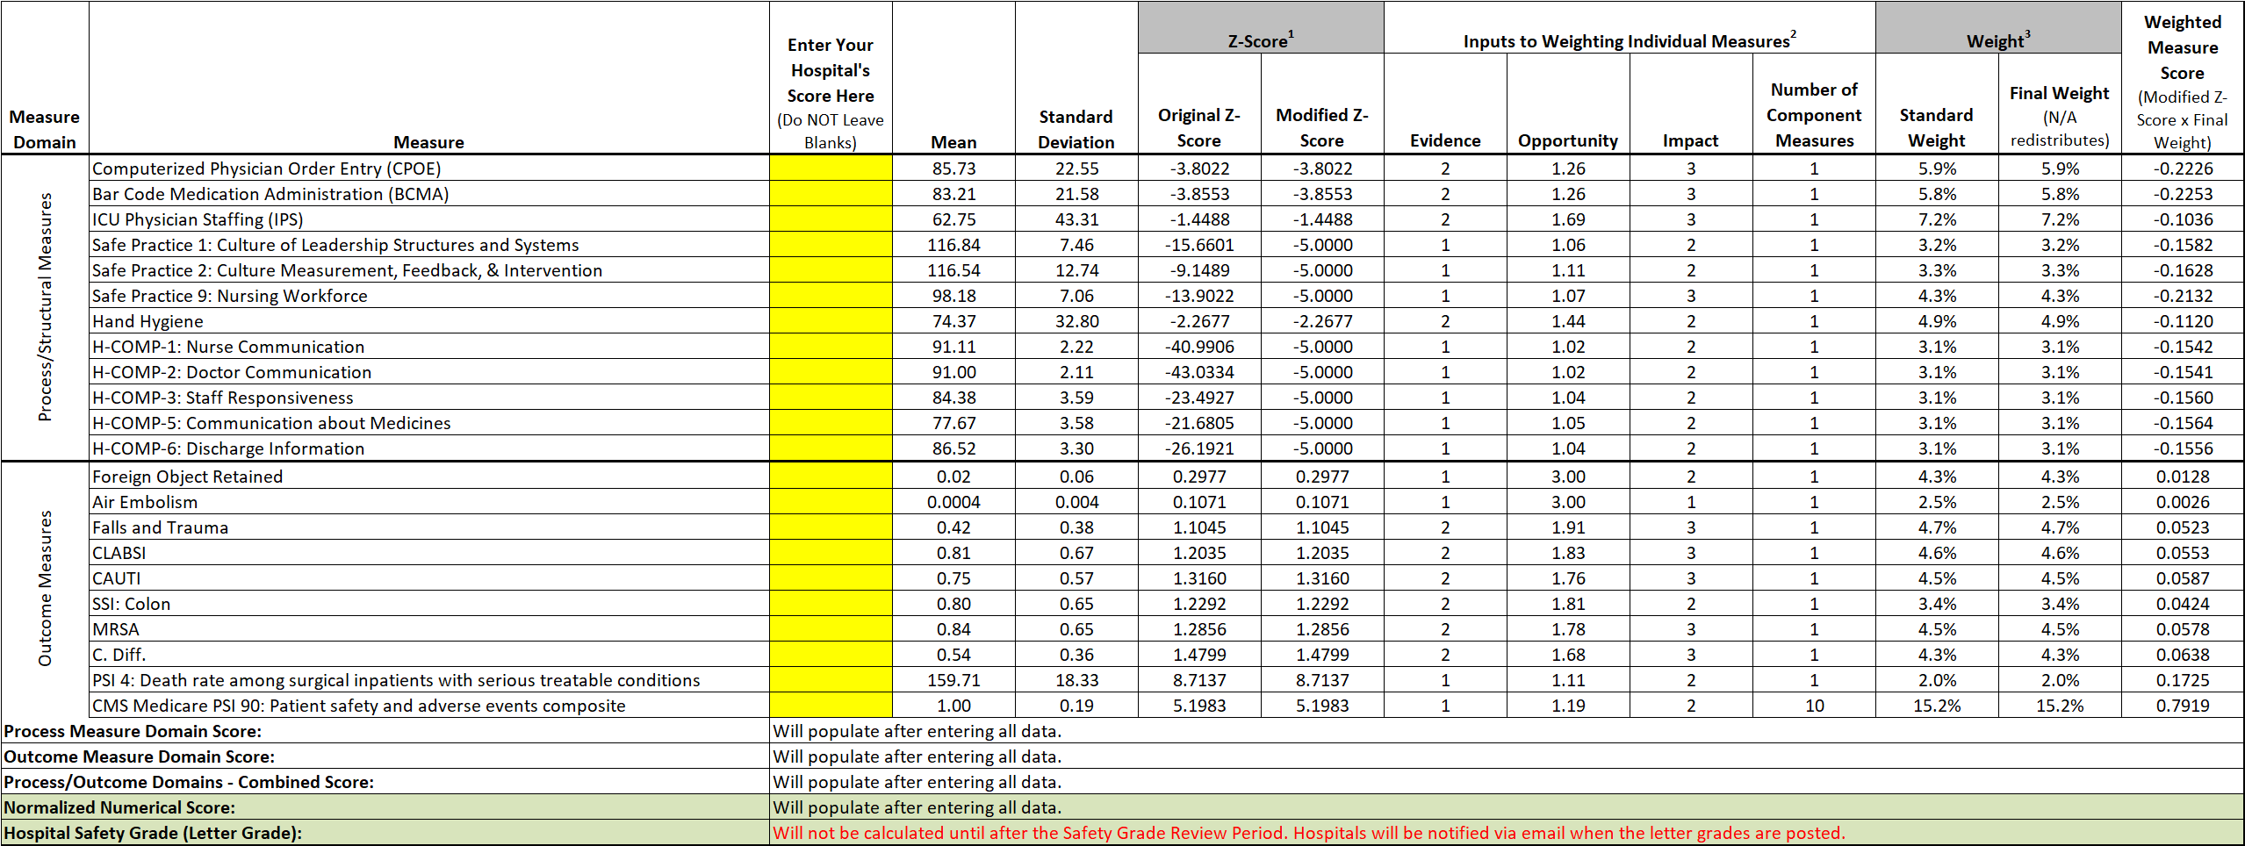
Hospital Safety Grade Calculator

Slide 37
PUBLIC REPORTING

Slide 38

HospitalSafetyGrade.org

Slide 39
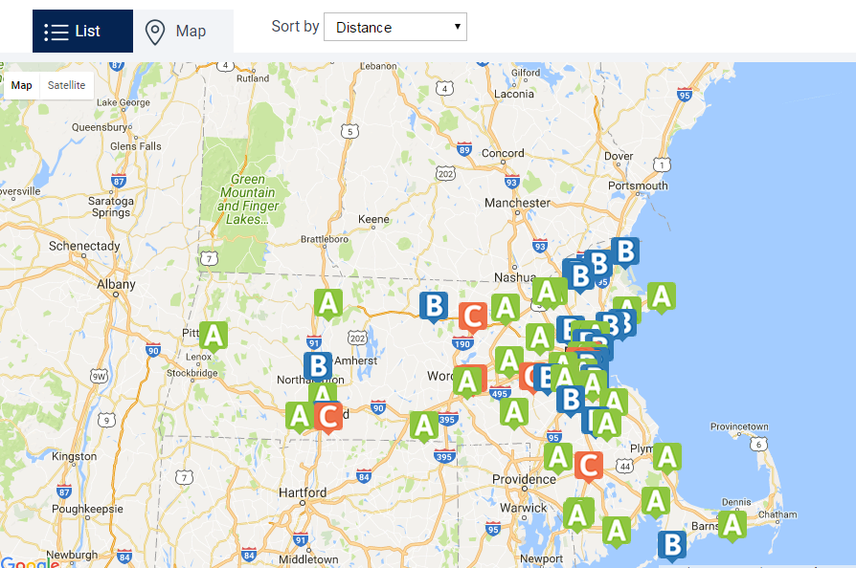
Search by Hospital Name and Location

Slide 40
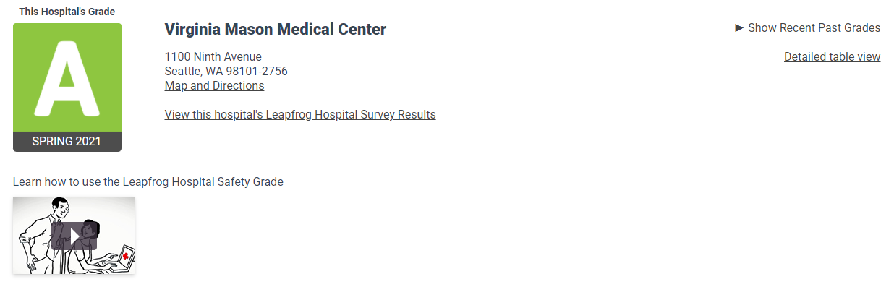
Hospital Details

Slide 41
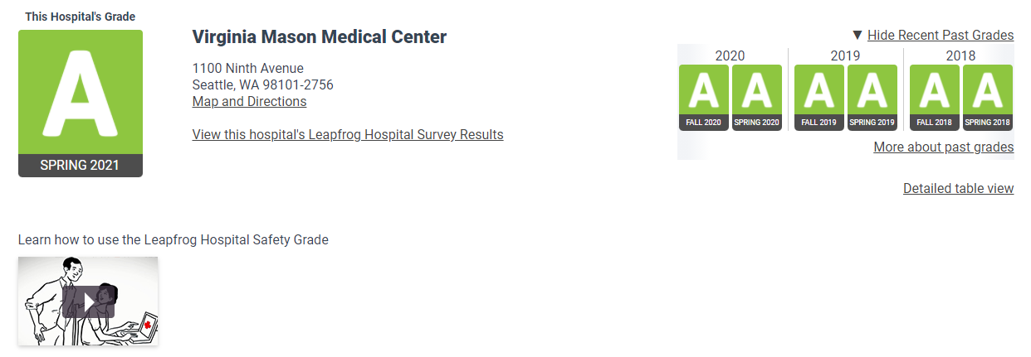
Past Grades

Slide 42
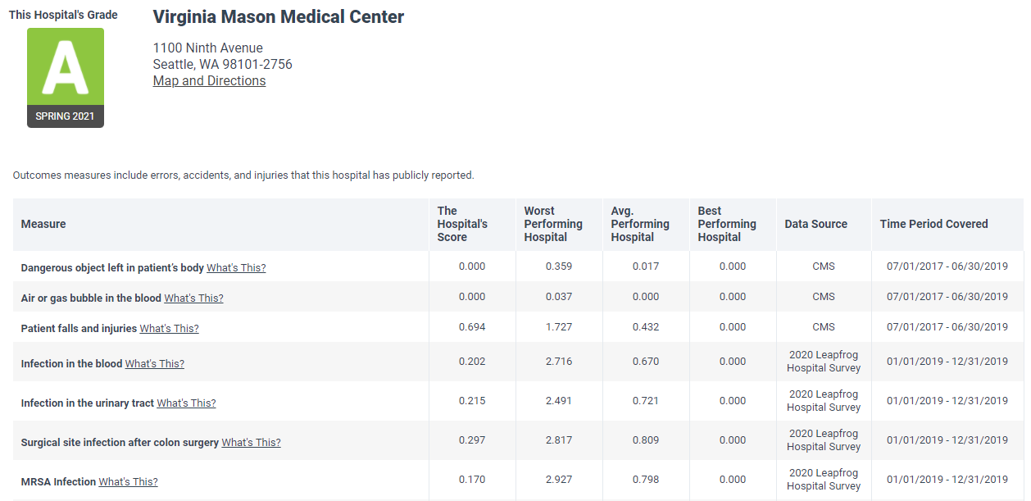
Detailed Table View for Hospitals
Remember to print a copy of your spring 2021 data and letter grade.
Notes:
Easier way to print all of the information from the Fall 2019 grade

Slide 43
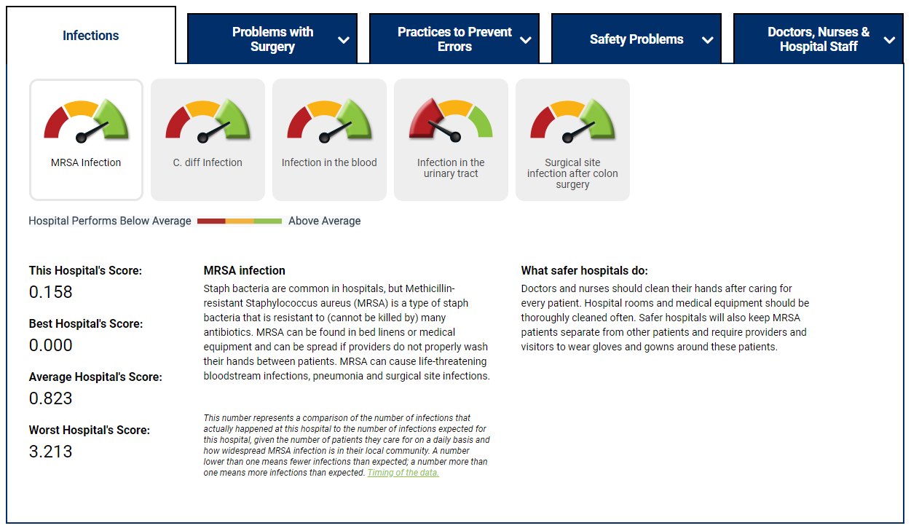
Measure Scores

Slide 44
Important Dates
August 31 - Data Snapshot Date
For hospitals that have submitted a 2021 Survey by August 31 - E-mail sent to the hospital CEO and primary survey contact listed in the profile section of the online Leapfrog Hospital Survey
For Hospitals that did not submit a 2021 Survey – Letter sent to CEO via USPS
Both e-mails and letters will include:
Information about the Leapfrog Hospital Safety Grade
Username/password to a secure website where hospitals can review the source data that Leapfrog used to calculate their numerical score
Links to the Hospital Safety Grade Help Desk and other helpful documents
September 20 – October 10 – Courtesy 3-week Hospital Safety Grade Review Period
September 28 – Hospital Safety Grade Town Hall Call
Late October – Letter Grade Embargo Period
Mid-November – Letter grades will be published at www.HospitalSafetyGrade.org
For more information about important dates, visit https://www.hospitalsafetygrade.org/for-hospitals/key-dates-and-information

Slide 45
More Information
Leapfrog Help Desk: https://leapfroghelpdesk.zendesk.com
Hospital Safety Grade Website: www.HospitalSafetyGrade.org

