Slide 1
Overview of the AHRQ QI Toolkit for Hospitals
Courtney Gidengil, MD MPH
Peter Hussey, PhD
RAND Corporation

Slide 2
Overview
What is the toolkit?
How was the toolkit developed?
What tools are in the toolkit? how can they be used for quality improvement at my hospital?

Slide 3
What Is the Toolkit?
Set of tools that hospitals can use to help improve performance in quality and patient safety
The AHRQ Quality Indicators (QIs)
  Inpatient Quality Indicators (IQIs)
  Patient Safety Indicators (PSIs)
Targeted to wide range of hospitals
  Independent or system-affiliated
  Varying quality improvement experience

Slide 4
Toolkit Development
Developed through the AHRQ ACTION program
RAND partnered with UHC to develop and test the toolkit

Slide 5
How Hospitals Can
Use the Toolkit
Applicable for hospitals with differing knowledge, skills, and needs
Serves as a “resource inventory” from which hospitals can select tools
Different audiences for each tool
(e.g., quality officer, finance officer, programmer)

Slide 6
What Are the Quality Indicators?
Inpatient Quality Indicators –
28 indicators of quality in four sets
  Volume, counts (6)
  Mortality for conditions, rates (7)
  Mortality for procedures, rates (8)
  Utilization, rates (7)
Patient Safety Indicators –
  17 indicators and a composite indicator
  Screen for adverse events for inpatients
  Expressed as rates

Slide 7
The Development Process
Toolkit version 1 – released in 2011
  Developed “alpha” toolkit
  Field tested and evaluated
  Revised and published the toolkit
Toolkit version 2 – released in 2014
  Added best practice forms for additional indicators
  Brought all tools up to date

Slide 8
Tool Development Steps
Established principles to guide toolkit development
Reviewed literature to guide design
Developed outline of toolkit based on steps of a quality improvement process
Identified and developed specific tools for each step

Slide 9
Technical Advisory Panel
Various skills and perspectives
  Hospital experience
  Quality improvement
  Relevant research skills
Providing guidance throughout toolkit development
  Toolkit design principles
  Content of the tools

Slide 10
Principles Guiding
Toolkit Development
Parsimony in tool choice and design
Target the most important factors for implementation
Provide tools that offer most value for a range of hospitals
Readily accessible content
Enable hospitals to assess effectiveness of their actions

Slide 11
Field Test Feedback
The tools were judged by the hospitals to be usable and useful
Hospitals varied widely in how many and which tools they chose to apply
Toolkit was useful for achieving staff consensus on the extent of quality gaps and on evidence-based practices

Slide 12
Three Key Learnings
Hospitals need to trust their data
Priority-setting is challenging
Keep the tools short and simple

Slide 13
Revised Toolkit
To Address These Issues
Added a documentation and coding tool to improve PSI validity
Made prioritization matrix tools flexible so a hospital can tailor it with factors it considers in priority-setting
Simplified tools and instructions to increase usability

Slide 14
Next Steps
Developing a pediatric toolkit
  Following similar development process, with field test and evaluation
Release planned in spring 2016

Slide 15
Structure of the Toolkit
Introduction and Roadmap
A. Readiness to Change
B. Applying QIs to the Hospital Data
C. Identifying Priorities for Quality Improvement
D. Implementation Methods
E. Monitoring Progress and Sustainability
of Improvements
F. Return-on-Investment Analysis
G. Existing Quality Improvement Resources

Slide 16
The Roadmap
A navigational guide through the toolkit
For each tool, it summarizes:
  Action step being taken
  Brief description of the tool
  Key audience(s) to use the tool
  Position with lead role responsibility

Slide 17
A. Readiness to Change
Tools A.1a and A.1b. Fact Sheets on Inpatient Quality Indicators (IQI) and Patient Safety Indicators (PSI)
  Introduces the IQIs and PSIs
  Provide 2011 national rates where available for each indicator (based on HCUP data)
  Indicates National Quality Forum endorsement status for each indicator

Slide 18
A. Readiness to Change
Tool A.2. Board/Staff PowerPoint® Presentation on the Quality Indicators
  Helps Board members and relevant staff understand the importance and financial and clinical implications of the AHRQ Quality Indicators
  The "notes" view in PowerPoint® has additional instructions for using this tool

Slide 19
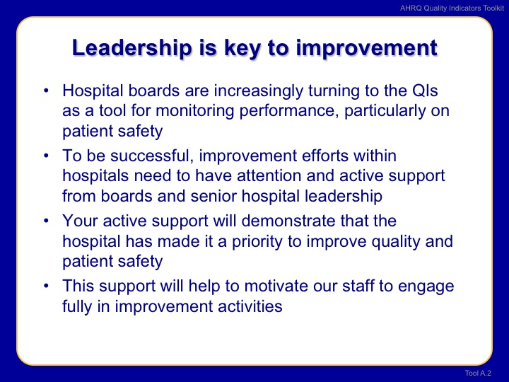
Tool A.2 Board/Staff PowerPoint® Presentation

Slide 20
A. Readiness to Change
Tool A.3. Getting Ready for Change Self-Assessment
  Provides a checklist to assess for capabilities that should be in place before implementing improvement efforts
    Infrastructure for change management
    Readiness to work on the AHRQ QIs
  Senior executives review this tool independently (e.g. CMO, chief quality officer, nursing leadership, and members of hospital’s quality committee), then meet to discuss

Slide 21
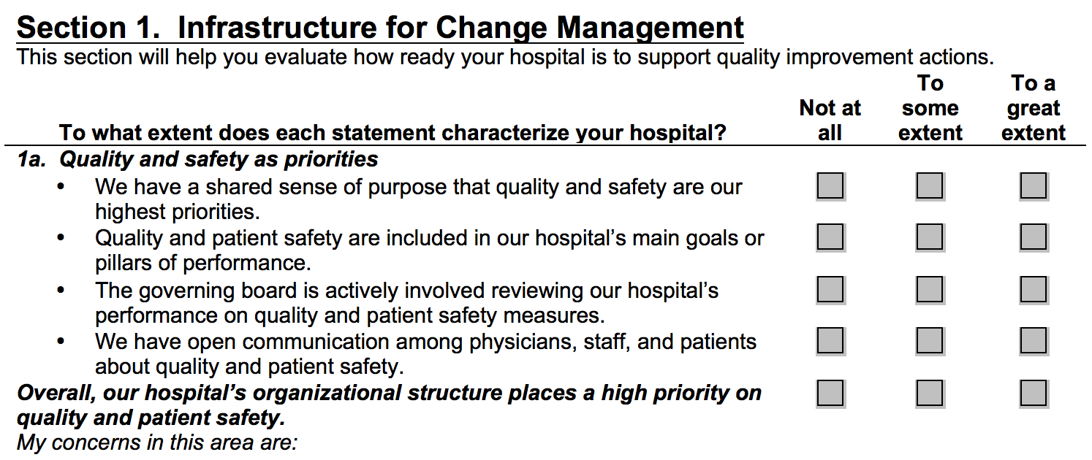
Tool A.3. Getting Ready for Change Self-Assessment

Slide 22
B. Applying QIs to Hospital Data
Tool B.1. Applying the AHRQ Quality Indicators to Hospital Data
  Overview of the AHRQ QIs, data requirements, and issues involved in using them
  Descriptions of the rates calculated for the QIs and how to work with them
  Example of how to interpret a hospital’s QI rates
  Guidance for assessing performance on the QIs (trends and benchmarking)

Slide 23
B. Applying QIs to Hospital Data
Tools B.2a and B.2b. IQI and PSI Rates Generated by the AHRQ SAS Programs (a) and Windows QI Software (b)
  Outline of the steps and programs used to calculate rates for the IQIs and PSIs
  Notes for analysts and programmers on issues to manage in working with the SAS programs/Windows software
  Example of the output from the SAS programs/Windows software for one hospital

Slide 24
B. Applying QIs to Hospital Data
Tool B.3a. Excel® Worksheets for Charts on Data, Trends, and Rates To Populate the PowerPoint® Presentation
  Takes the rates for your hospital’s performance on the AHRQ Quality Indicators (QIs) and displays them graphically
Tool B.3b. PowerPoint® Presentation: The AHRQ Quality Indicators, Results, and Discussion of Data Analysis
  Provides a PowerPoint template for presenting the results of your analysis

Slide 25
Tool B3b: Comparing Hospital’s Performance to National Performance Over Time
Notes:
This chart comes from the Excel worksheet (trend-risk-adjusted-benchmark).

Slide 26
B. Applying QIs to Hospital Data
Tool B.4. Documentation and Coding for Patient Safety Indicators
  Designed to facilitate improvements to documentation and coding processes to ensure that PSI rates are accurate
    Describes procedures to address problems with documentation and coding practices
    Illustrates issues that can arise when documenting and coding each PSI

Slide 27
B. Applying QIs to Hospital Data
Tool B.5. Assessing Indicator Rates Using Trends and Benchmarks
  Supports the development of trend and benchmark information for comparing your hospital’s current performance on the QI rates:
    to performance in previous years (trends)
    to similar hospitals (benchmarks)
  Can help identify which QIs the hospital may need to address for quality improvement

Slide 28
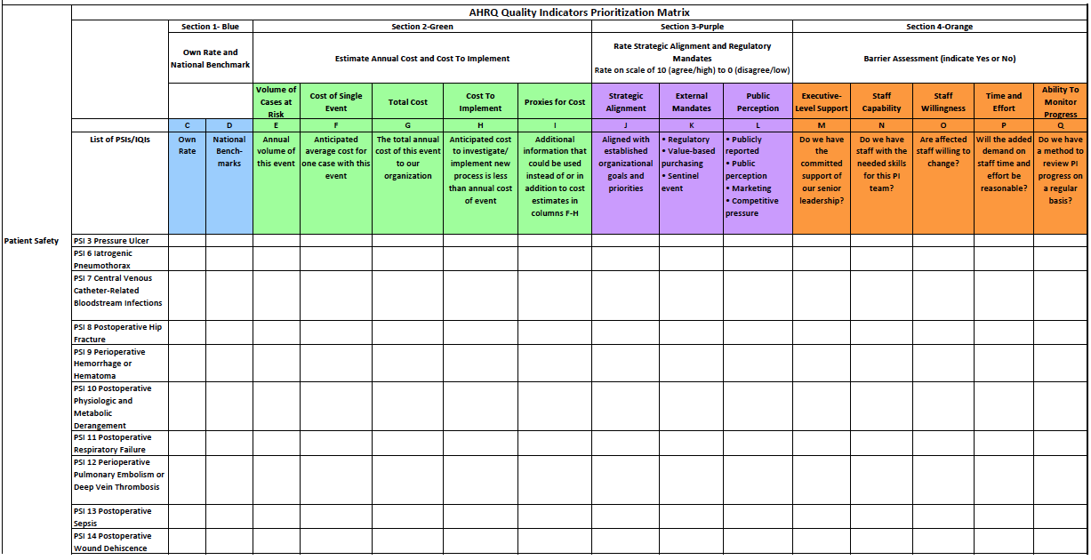
C. Identifying Priorities for Quality Improvement
Tool C.1. Prioritization Matrix
Tool C.2. Prioritization Matrix Example

Slide 29
D. Implementation Methods
Tool D.1. Improvement Methods Overview
  Provides framework to evaluate current systems in place, and promote development of new systems and processes of care
Tool D.2. Project Charter Template
  Charter template to describe the performance improvement rationale, goals, barriers, and anticipated resources which the team will commit

Slide 30
D. Implementation Methods
Tool D.4. Best Practices and Suggestions for Improvement
  Tool D.4 is an introduction to the best practices tool
  Tools D4.a through D4.n outline best practices for 14 PSIs and a more general mortality review relating to mortality-based IQIs

Slide 31
Best Practices Tool
Covers the following PSIs
  PSI 03 Pressure Ulcer Rate
  PSI 05 Retained Surgical Item or Unretrieved Device Fragment Count
  PSI 06 Iatrogenic Pneumothorax Rate
  PSI 07 Central Venous Catheter-Related Blood Stream Infection Rate
  PSI 08 Postoperative Hip Fracture Rate
  PSI 09 Perioperative Hemorrhage or Hematoma Rate
  PSI 10 Postoperative Physiologic and Metabolic Derangement Rate
Notes:
Bolded PSIs are the PSI measures that Leapfrog includes in the Hospital Safety Score

Slide 32
Best Practices Tool
Covers the following PSIs (cont’d)
  PSI 11 Postoperative Respiratory Failure Rate
  PSI 12 Perioperative Pulmonary Embolism or Deep Vein Thrombosis Rate
  PSI 13 Postoperative Sepsis Rate
  PSI 14 Postoperative Wound Dehiscence Rate
  PSI 15 Accidental Puncture or Laceration Rate
  PSIs 18 and 19 – Obstetric Trauma Rate – Vaginal Delivery With/Without Instrument
Does not include PSI 4 (Death Rate Among Surgical Inpatients With Serious Treatable Conditions)
Notes:
Bolded PSIs are the PSI measures that Leapfrog includes in the Hospital Safety Score

Slide 33
Best Practices Form Components
“Why Focus on….”
High-level summary of best practices
Recommended practices
  Staff required
  Equipment
  Communication
  Authority/Accountability
References

Slide 34
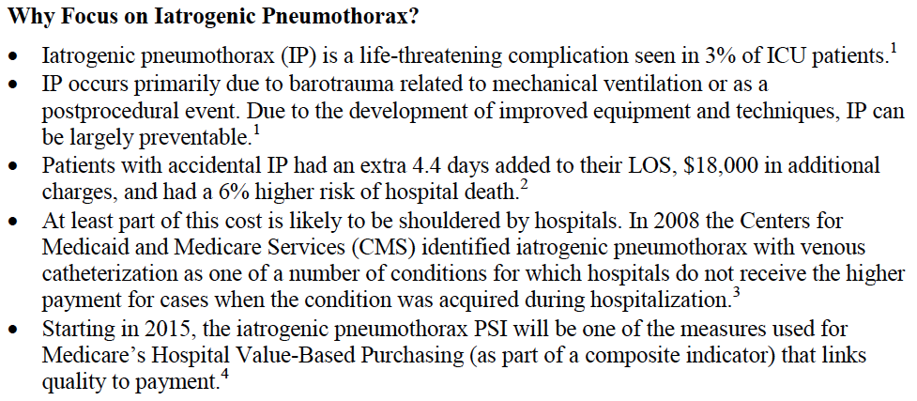
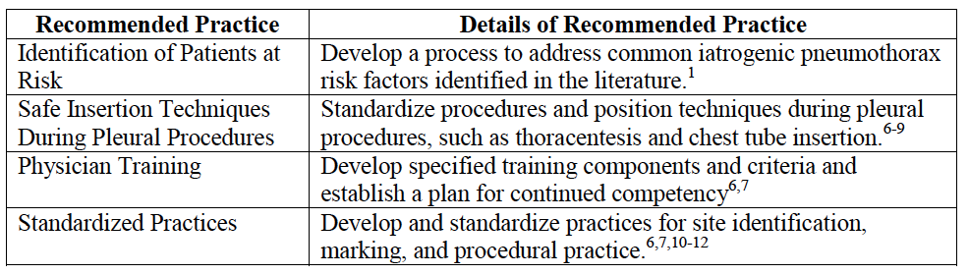
Sample Best Practices Form:
PSI 06

Slide 35
D. Implementation Methods
Tool D.5. Gap Analysis
  Understand the extent to which current practices align with best practices
Tool D.6. Implementation Plan
  Assign team responsibilities and set timeline

Slide 36
D. Implementation Methods
Tool D.7. Implementation Measurement
  Measure progress in improving work and clinical care processes
Tool D.8. Project Evaluation and Debriefing
  Understand what worked in the implementation process and what needs improvement

Slide 37
E. Monitoring Progress and Sustainability of Improvements
Tool E.1. Monitoring Progress for Sustainable Improvement
  What is involved in ongoing monitoring?
  Establish a schedule for regular reporting
  Develop report formats to communicate clearly
  Establish procedures for acting on problems identified
  Assess sustainability on a periodic basis

Slide 38
F. Return-on-Investment Analysis
Tool F.1. Return on Investment Estimation
  Step-by-step guide to calculating ROI
  Worksheets for calculating net costs and returns
  Case study for ROI calculation
  Additional guidance for effective ROI calculation
  Resources and information sources

Slide 39
G. Existing Quality Improvement Resources
Tool G.1. Available Comprehensive Quality Improvement Guides
  Obtain further guidance for conducting effective quality improvements
Tool G.2. Specific Tools To Support Change
  Identify specific analytic or action tools to use in improvement processes
Tool G.3. Case Study of PSI Improvement Implementation

Slide 40
Summary
The QI Toolkit supports hospitals that want to improve performance
Addresses all stages of improvement, from self-assessment to ongoing monitoring
The tools are practical, easy to use, and designed to meet a variety of needs
QI Toolkit available at: http://www.ahrq.gov/professionals/systems/hospital/qitoolkit/index.html

